Slide 1
Shane Stephens
Vice President – Cotton Services & Warehousing
July 11, 2019
Greenwood, MS

Slide 2
Discussion Topics
Bale Weights
Loan chart
Plastic Contamination
Moisture Damage
Metal Contamination
Fire & Insurance
Sustainability

Slide 3
Total Bales 12,176,043
Bales below 400 lbs. 5,324
Bales above 600 lbs. 1,282

Slide 4
Total Bales 2,617,281
Bales below 400 lbs. 1,388
Bales above 600 lbs. 599

Slide 5
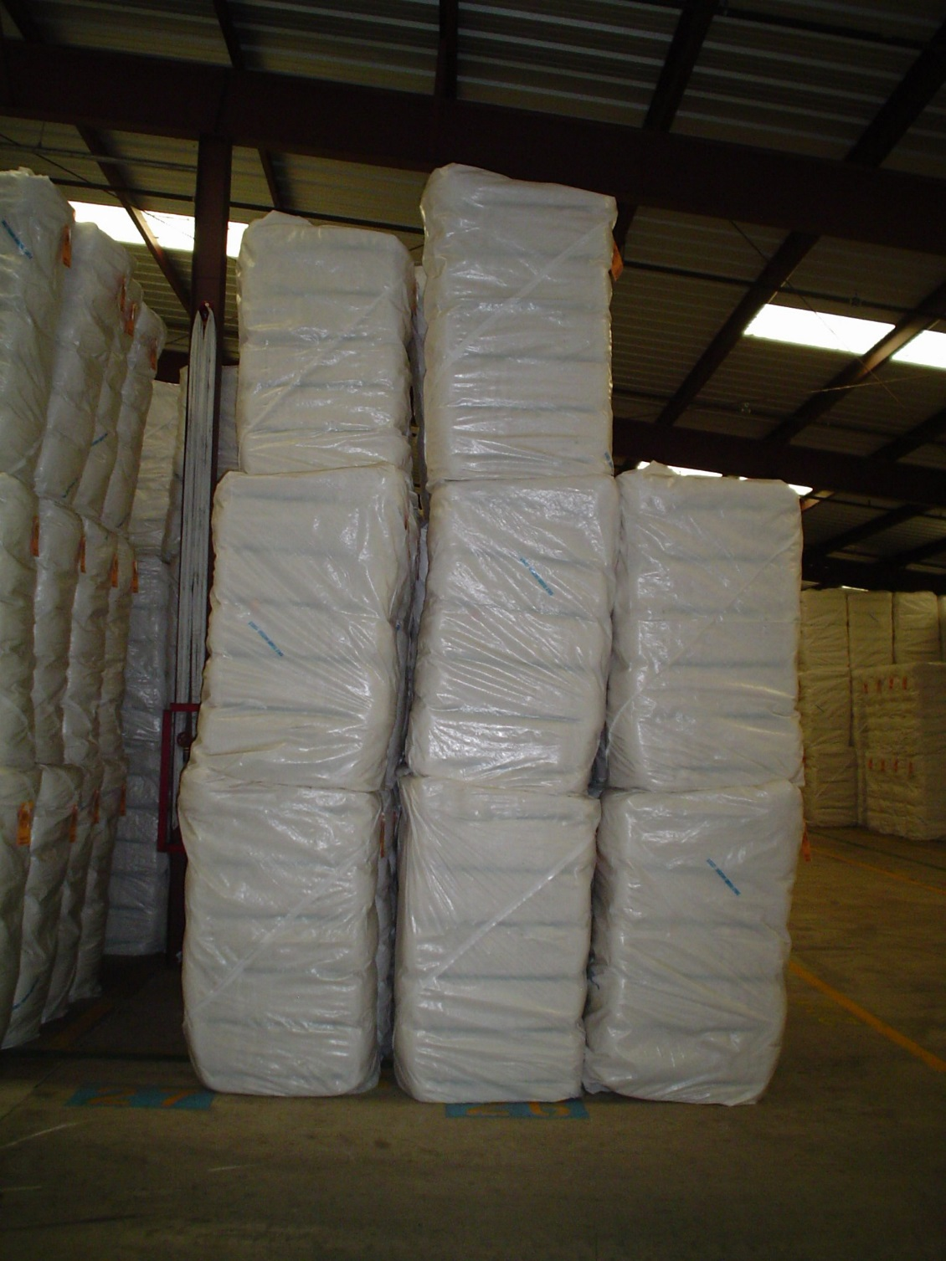

Slide 6
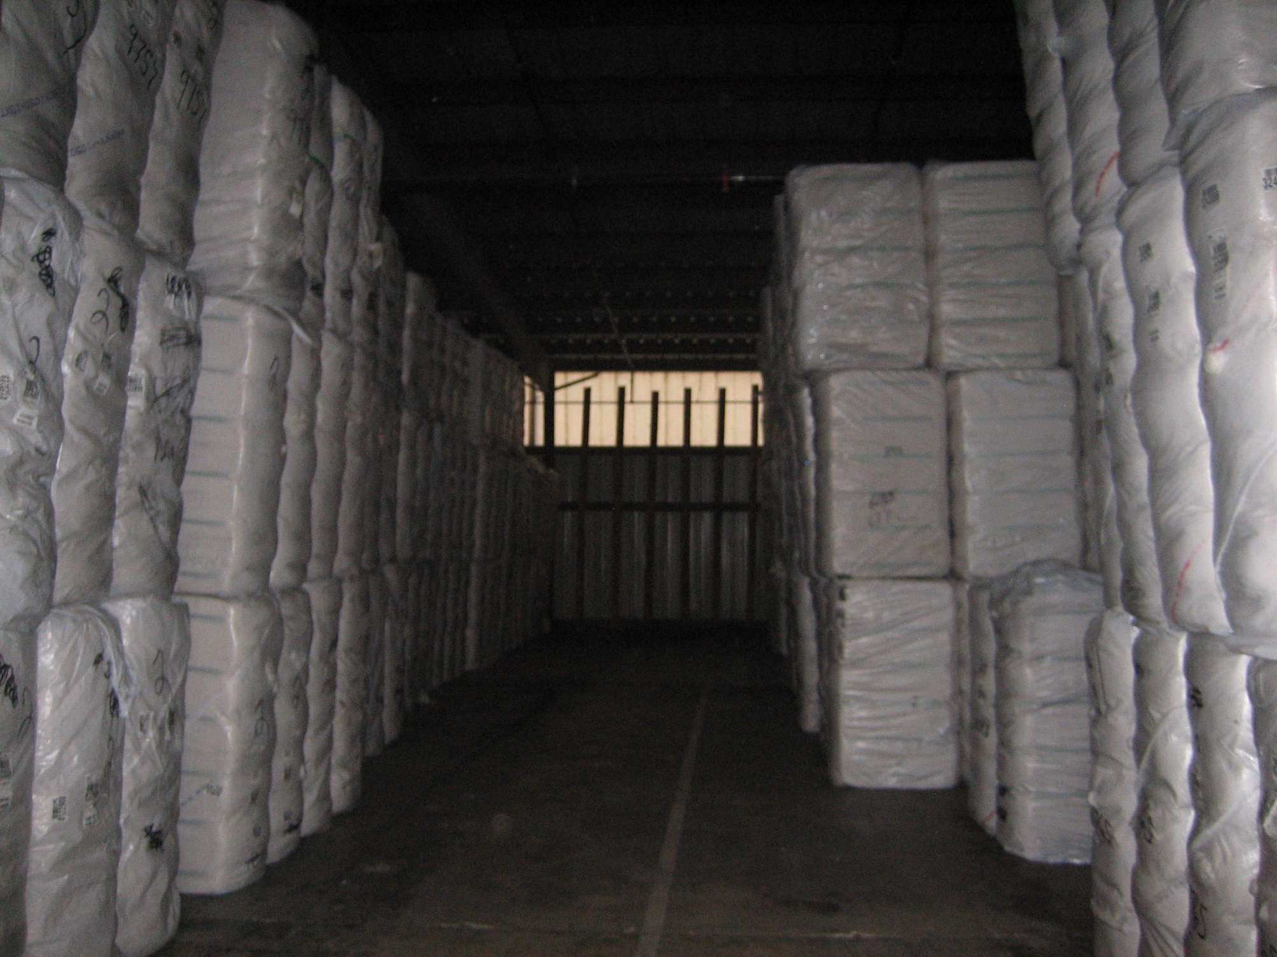

Slide 7
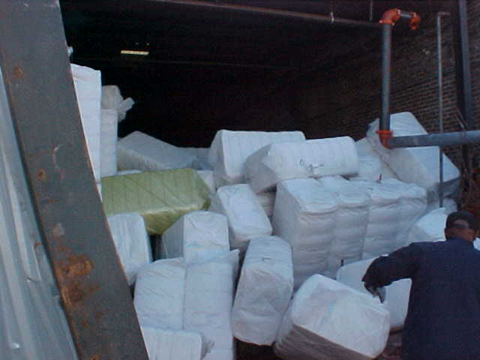

Slide 8
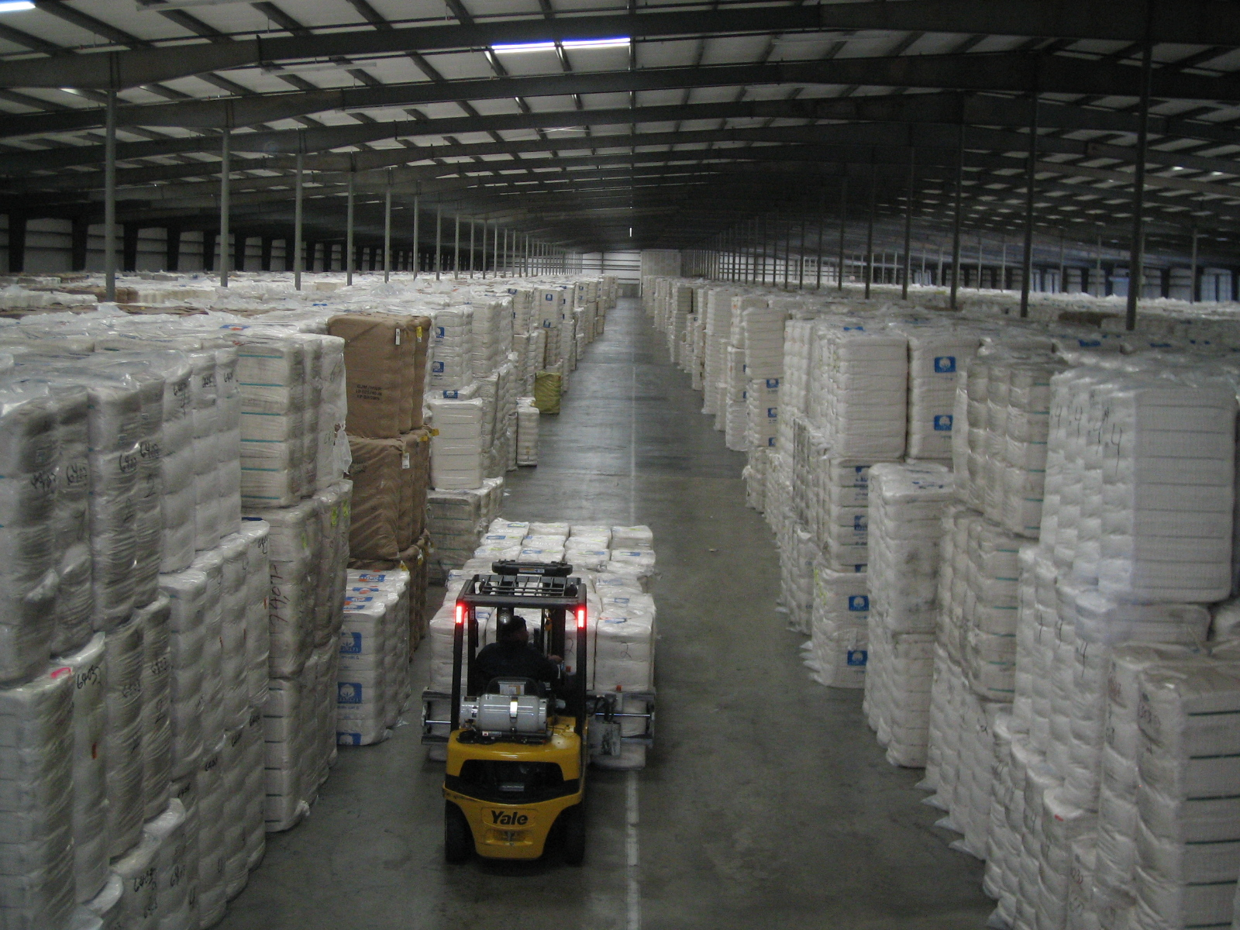

Slide 9
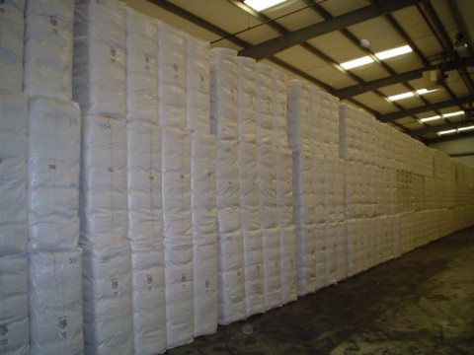

Slide 10
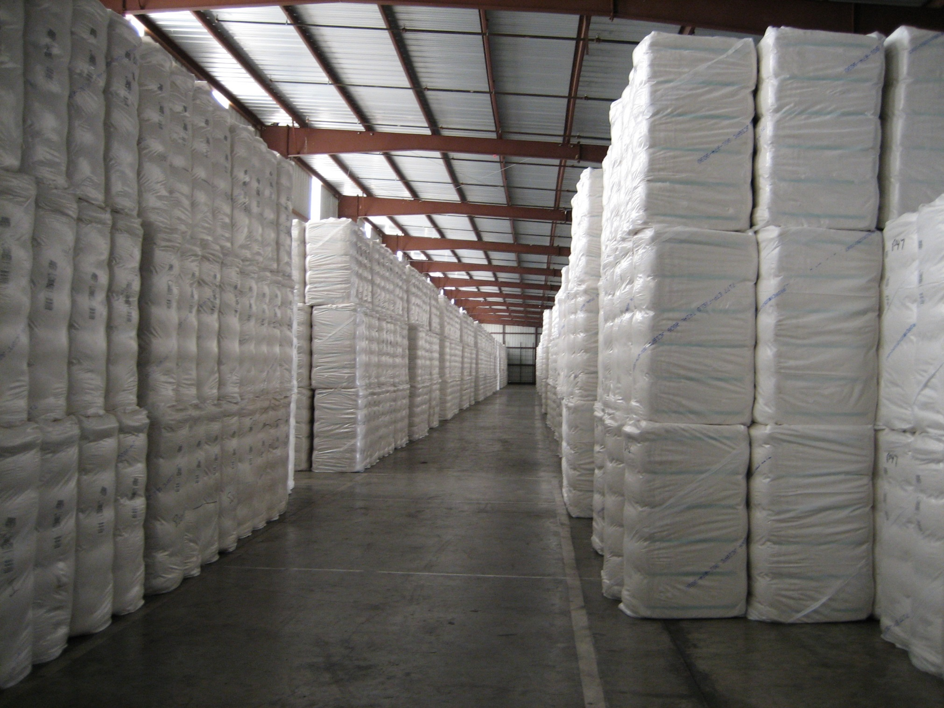

Slide 11
Memphis Cotton Exchange Rule 19
Effective with the 2011 Crop or August 1, 2011
Weight Penalties
Clause 1 For purposes of forward contracting, the term “bale” will refer to a bale of 500 pounds, with a tolerance of +/- 1%. Any loss incurred by buyer as a result of average bale weights outside this tolerance may be claimed back or withheld from payment for cotton delivered on the contract.
Effective with the 2003 Crop after August 1, 2003
Clause 2 In the delivery of cotton under these rules, bales weighing less than 464 pounds net must be penalized as follows:
For each bale weighing less than 464 pounds but not under 430 pounds - $3.00
For each bale weighing less than 430 pounds but not under 400 pounds - $6.00
Bales weighing less than 400 pounds may be rejected, but if accepted, must be penalized $20.00 per bale.
The following exception to the penalties out-lined above is made: Where any invoice averages 485 pounds or more, there will be no penalty, but bales weighing less than 400 pounds may be rejected.
Bales weighing more than 600 pounds net may be rejected.
Source: acsa-cotton.org

Slide 12
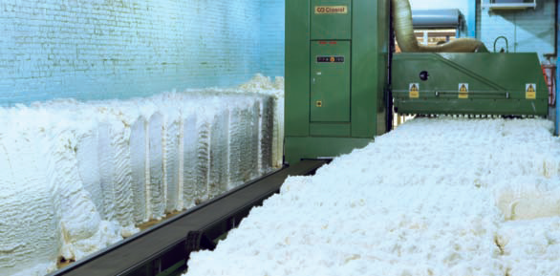

Slide 13
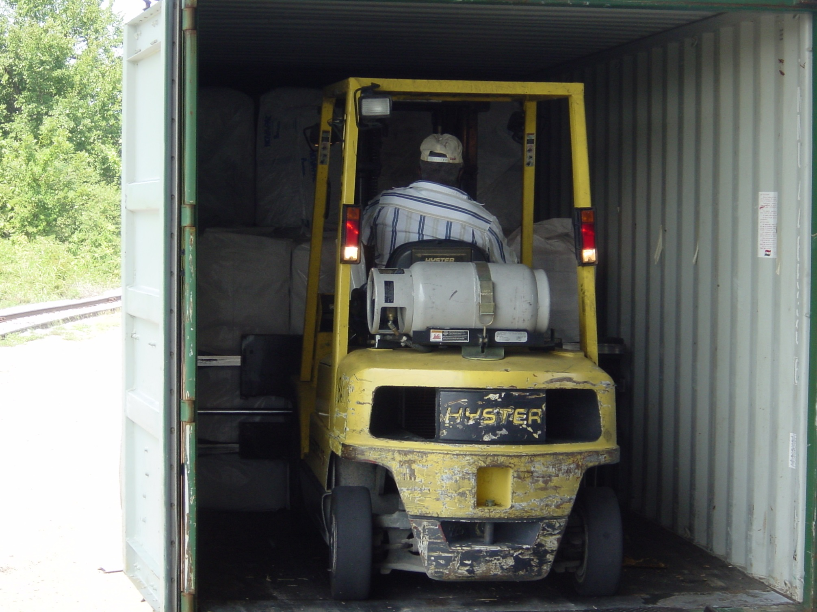

Slide 14
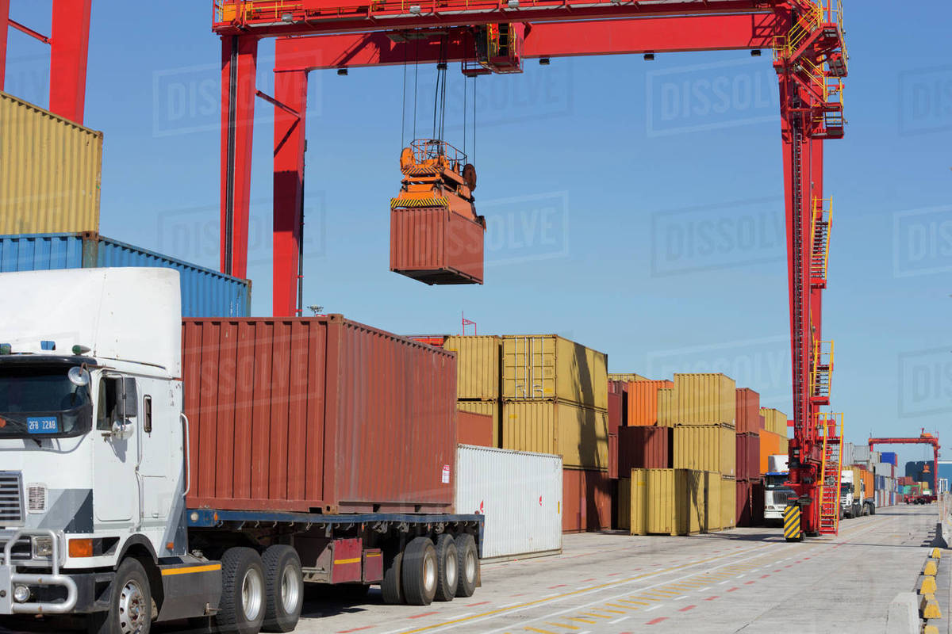

Slide 15
Discussion Topics
Bale Weights
Loan chart
Plastic Contamination
Moisture Damage
Metal Contamination
Fire & Insurance
Sustainability

Slide 16
2019 Loan Prem. and Dis. (Base = 52.00)
Cl | Lf | St | 2018 | 2019 | Diff | Cl | Lf | St | 2018 | 2019 | Diff
31 | 1-2 | 34 | 65 | 75 | 10 | 41 | 4 | 34 | 0 | 0 | 0
31 | 1-2 | 35 | 235 | 230 | -5 | 41 | 4 | 35 | 60 | 55 | -5
31 | 1-2 | 36 | 380 | 370 | -10 | 41 | 4 | 36 | 155 | 140 | -15
31 | 1-2 | 37 | 420 | 420 | 0 | 41 | 5 | 34 | -200 | -200 | 0
31 | 1-2 | 38 | 435 | 430 | -5 | 41 | 5 | 35 | -100 | -95 | 5
31 | 3 | 34 | 65 | 75 | 10 | 41 | 5 | 36 | -20 | -10 | 10
31 | 3 | 35 | 205 | 205 | 0 | 42 | 4 | 34 | -270 | -280 | -10
31 | 3 | 36 | 340 | 340 | 0 | 42 | 4 | 35 | -210 | -225 | -15
31 | 3 | 37 | 380 | 380 | 0 | 42 | 4 | 36 | -130 | -150 | -20
31 | 3 | 38 | 390 | 395 | 5 | 51 | 5 | 34 | -410 | -415 | -5
31 | 4 | 34 | 25 | 35 | 10 | 51 | 5 | 35 | -325 | -335 | -10
31 | 4 | 35 | 90 | 95 | 5 | 51 | 5 | 36 | -280 | -285 | -5
31 | 4 | 36 | 210 | 210 | 0 | 52 | 5 | 34 | -595 | -620 | -25
31 | 4 | 37 | 240 | 235 | -5 | 52 | 5 | 35 | -525 | -550 | -25
31 | 4 | 38 | 250 | 240 | -10 | 52 | 5 | 36 | -515 | -530 | -15
Micronaire | 2018 | 2019 | Diff | Strength | 2018 | 2019 | Diff | Uniformity | 2018 | 2019 | Diff
2.7-2.9 | -660 | -815 | -155 | 24.0-24.9 | -180 | -200 | -20 | 78.0-78.9 | -85 | -60 | 25
3.0-3.2 | -405 | -535 | -130 | 25.0-25.9 | -155 | -165 | -10 | 79.0-79.9 | -75 | -50 | 25
3.3-3.4 | -240 | -360 | -120 | 30.0-30.9 | 30 | 25 | -5 | 82.0-82.9 | 5 | 5 | 0
5.0-5.2 | -230 | -230 | 0 | 31.0-32.9 | 45 | 40 | -5 | 83.0-83.9 | 15 | 10 | -5
5.3 (+) | -385 | -380 | 5 | 33.0 (+) | 55 | 50 | -5 | 84.0-84.9 | 25 | 15 | -10

Slide 17
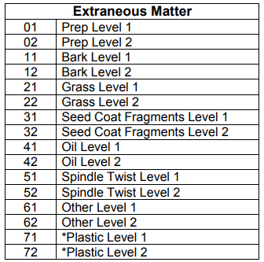

Slide 18
Discussion Topics
Bale Weights
Loan chart
Plastic Contamination
Moisture Damage
Metal Contamination
Fire & Insurance
Sustainability

Slide 19
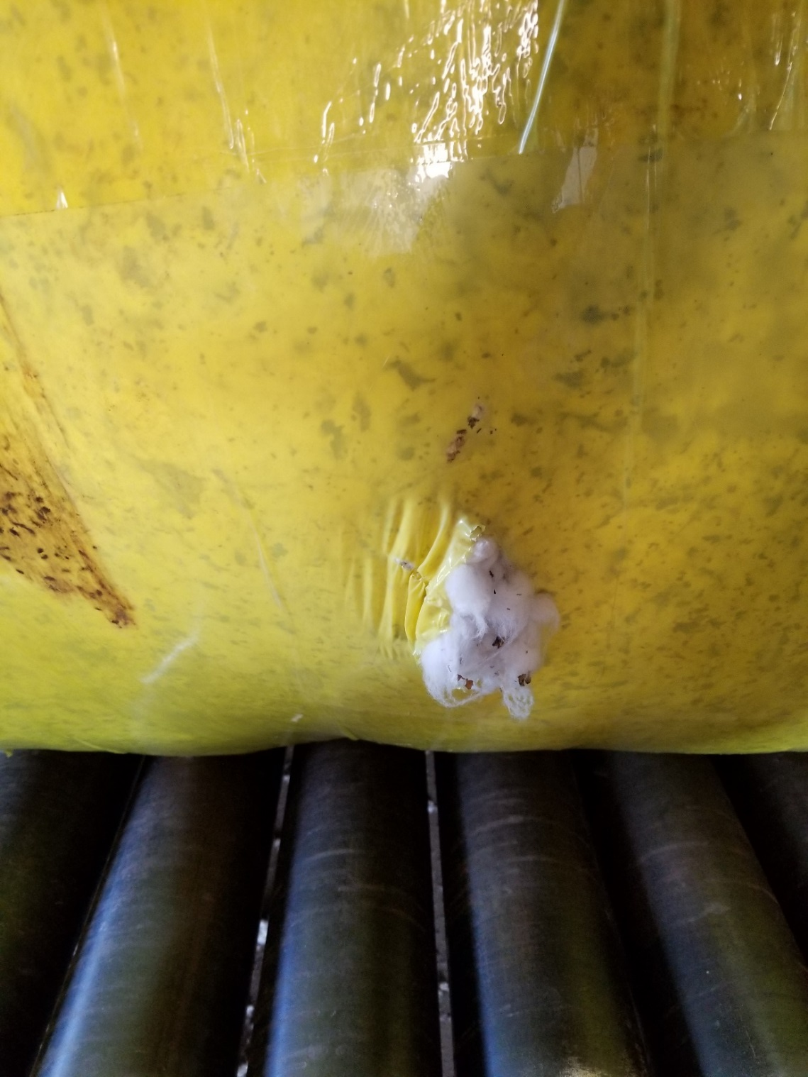
John Deere Module Wrap

Slide 20
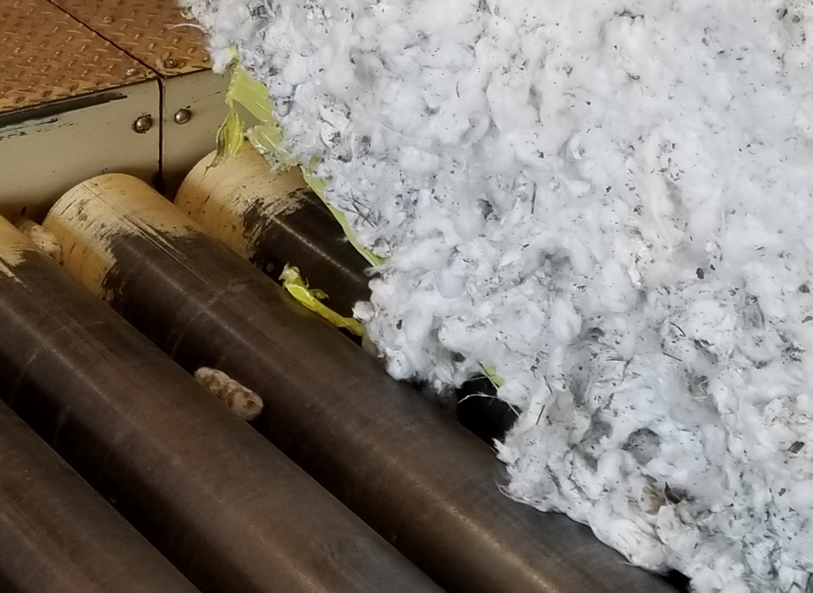
John Deere Module Wrap

Slide 21
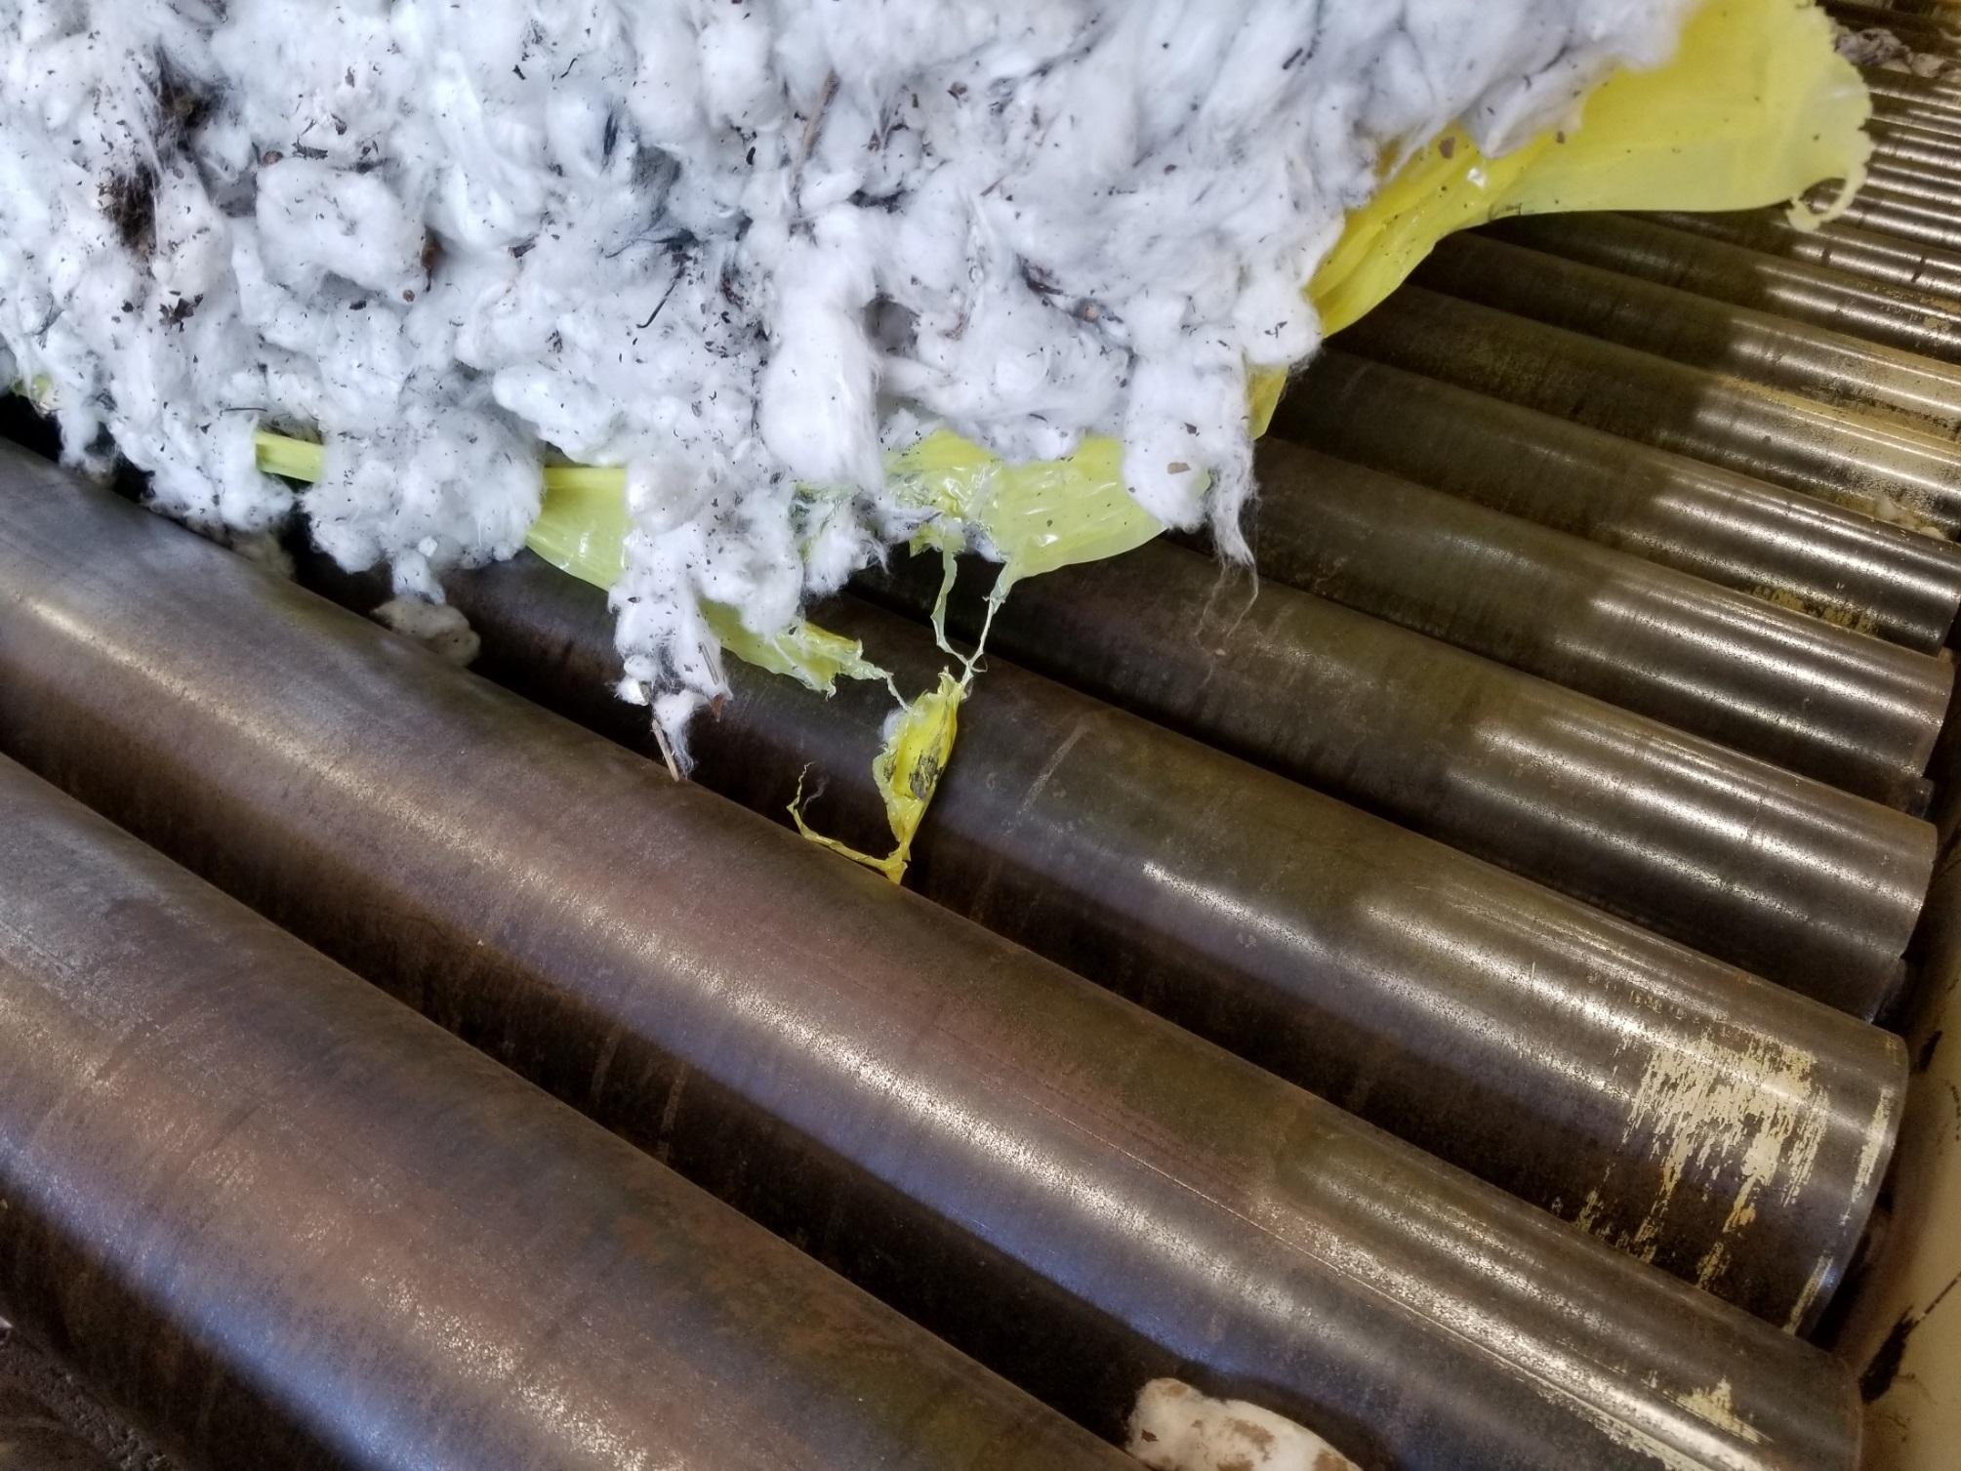
John Deere Module Wrap

Slide 22
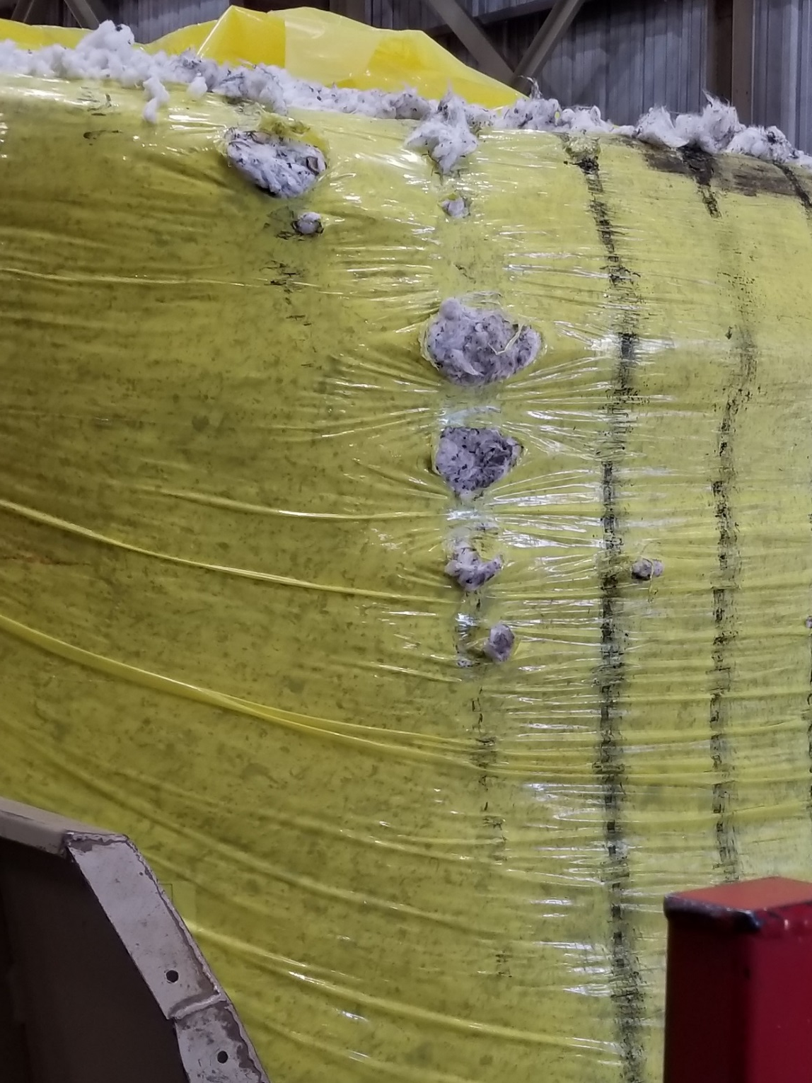
John Deere Module Wrap

Slide 23
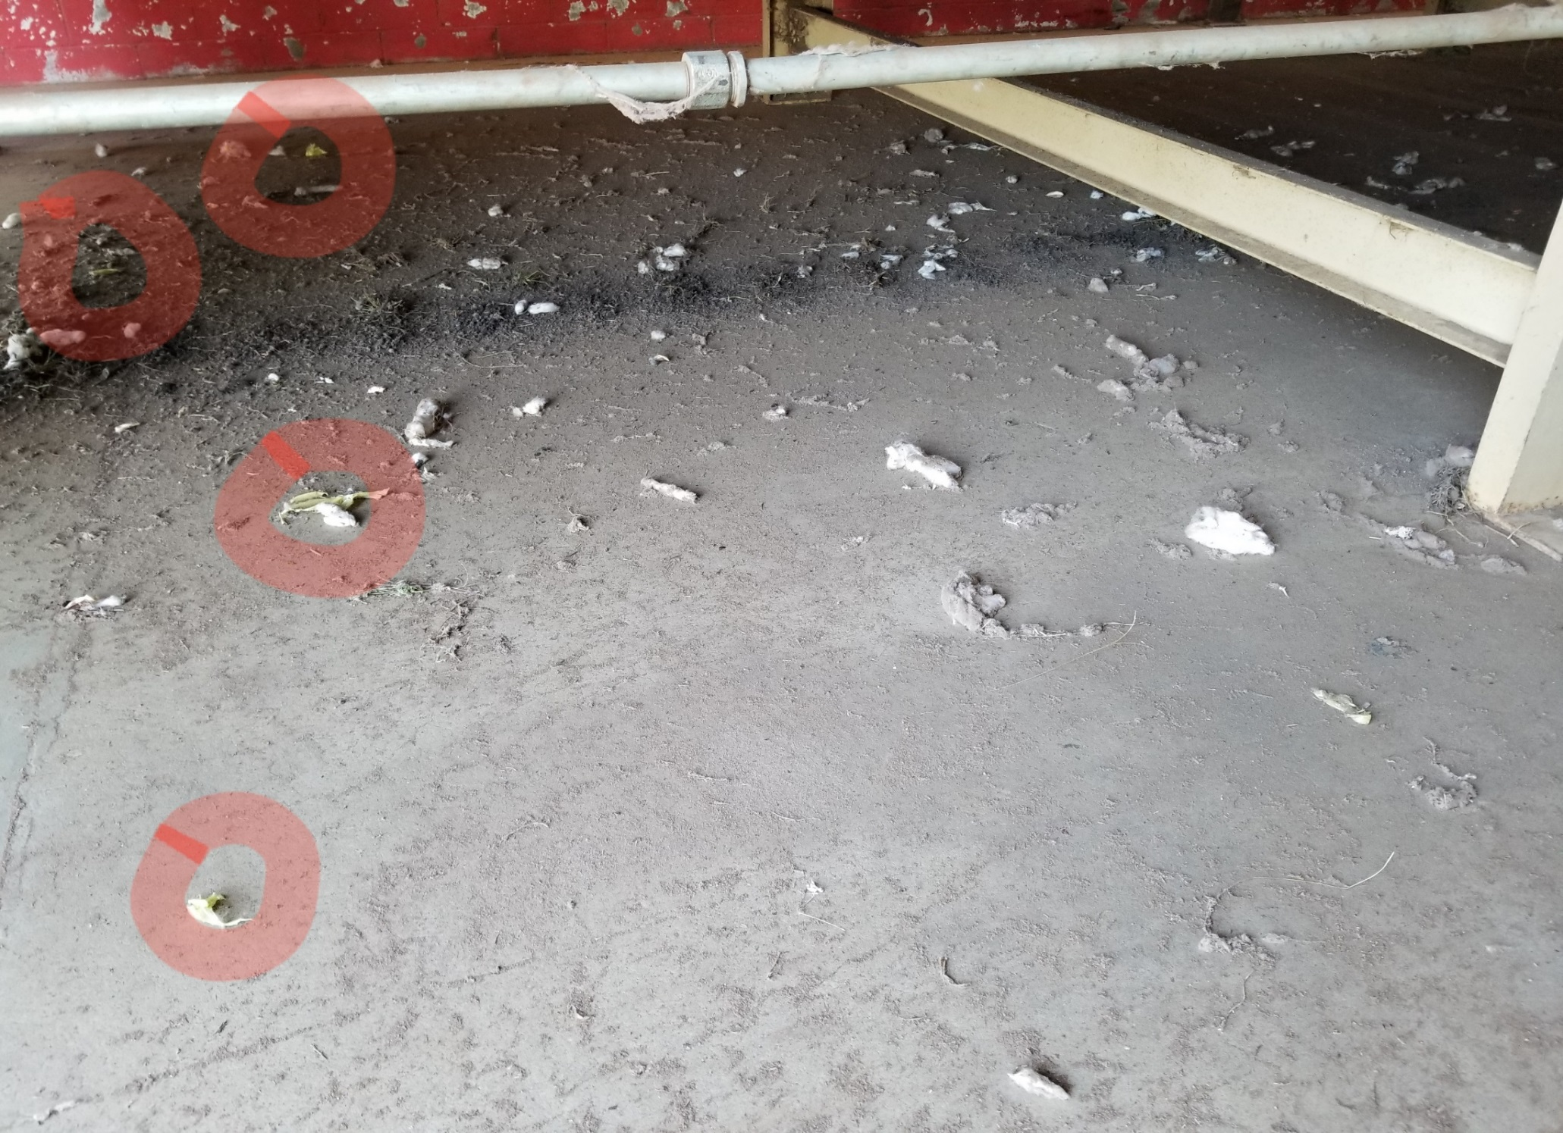
John Deere Module Wrap

Slide 24
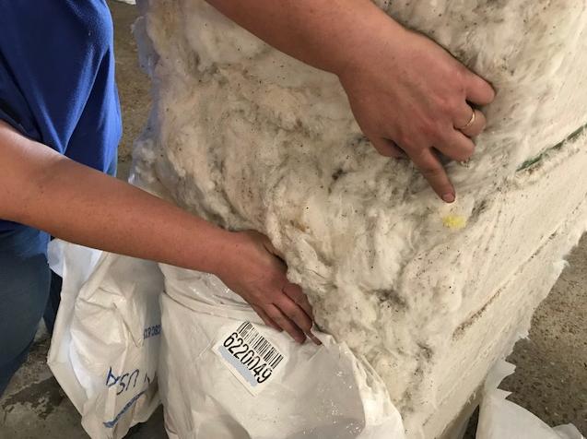
John Deere Module Wrap

Slide 25
Discussion Topics
Bale Weights
Loan chart
Plastic Contamination
Moisture Damage
Metal Contamination
Fire & Insurance
Sustainability

Slide 26
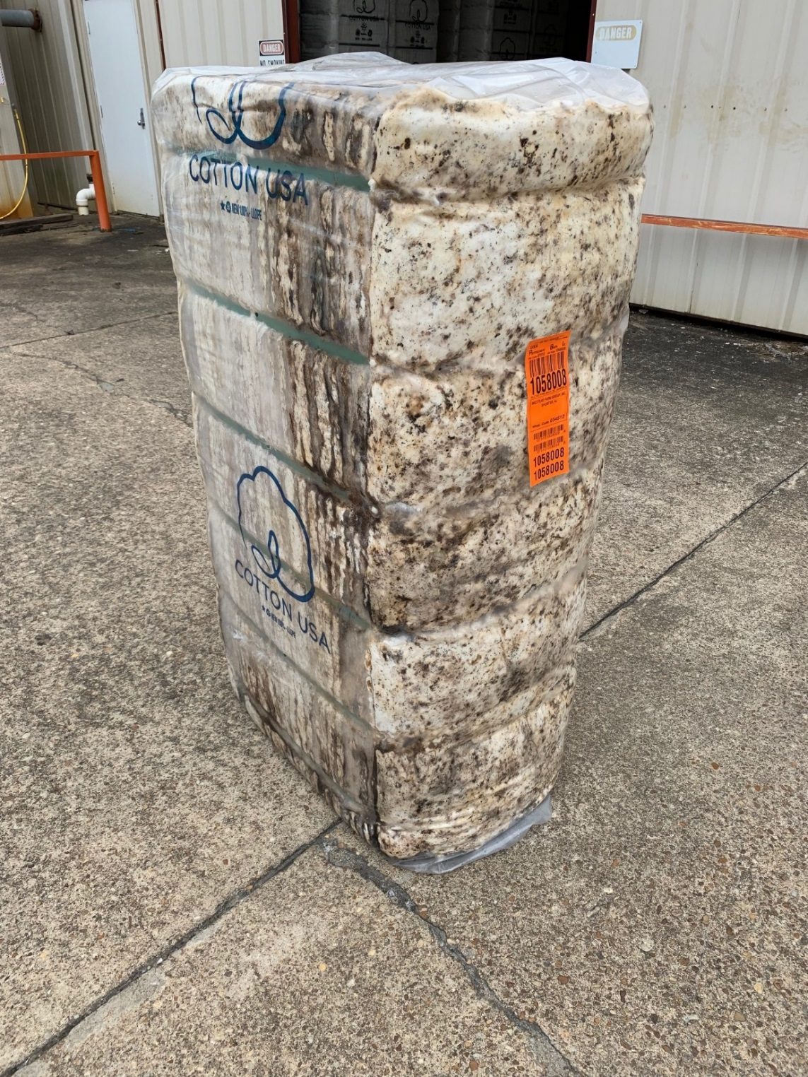
Water Damage

Slide 27
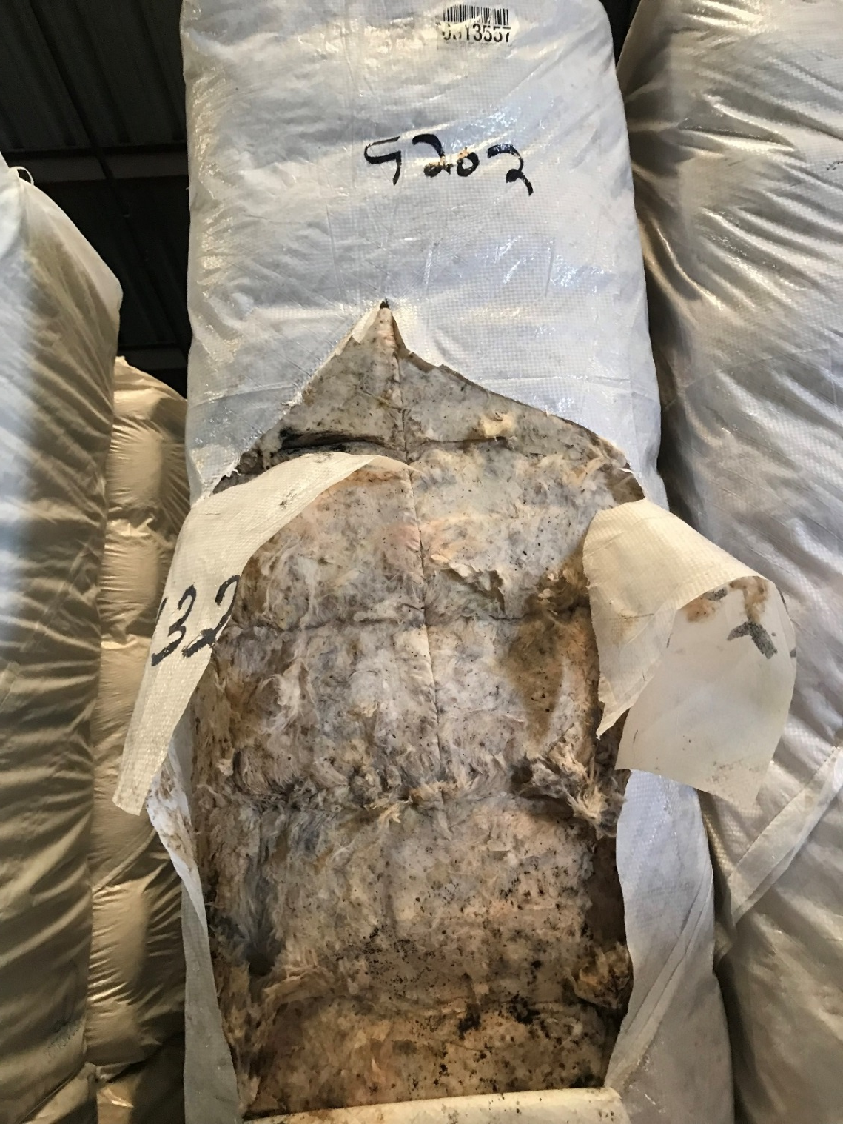
Water Damage

Slide 28
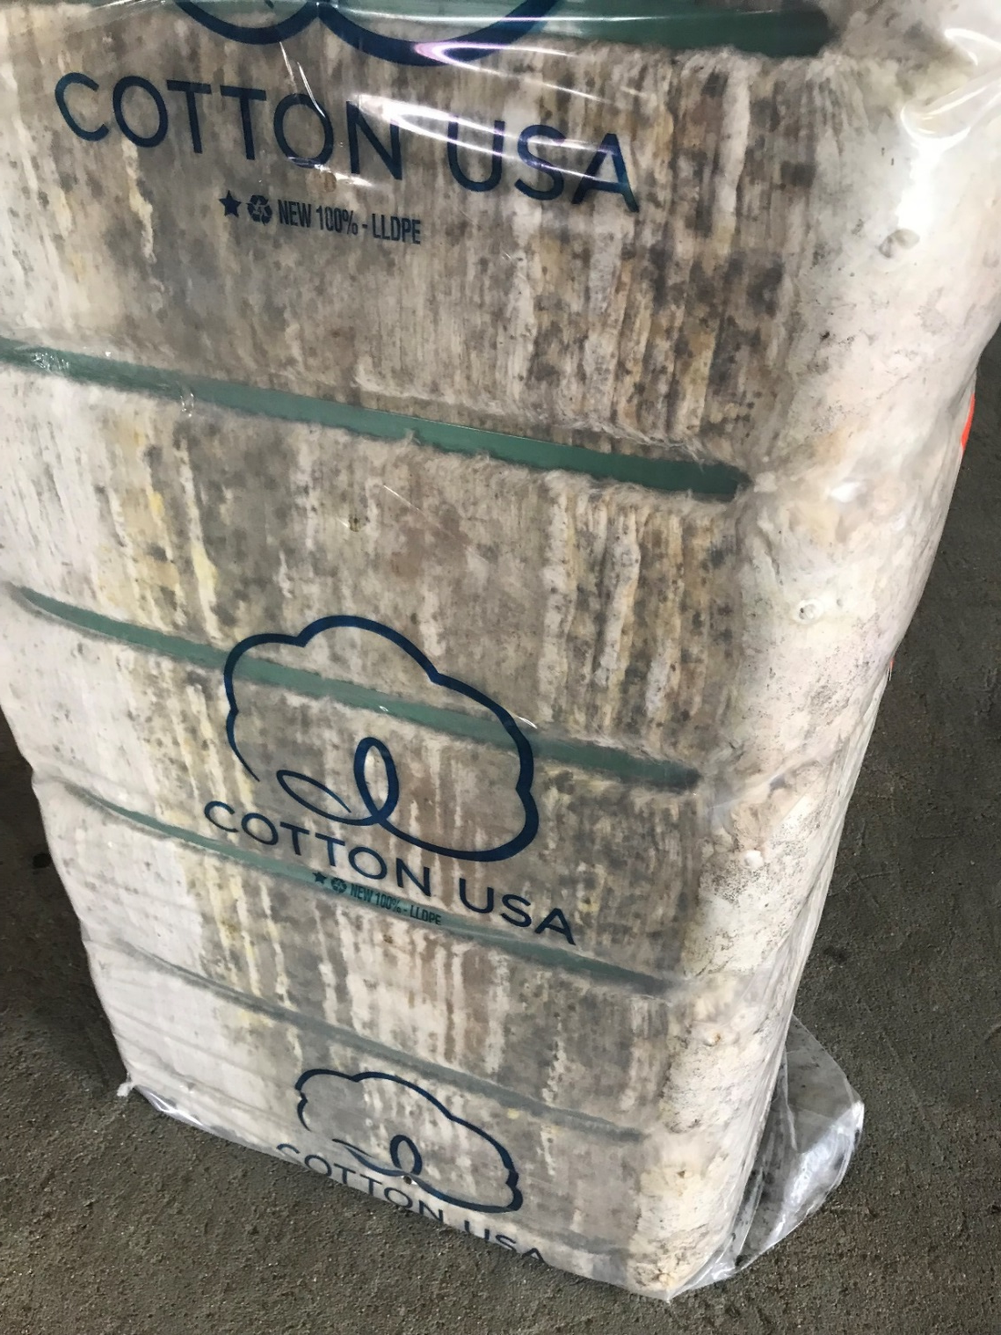
Water Damage

Slide 29
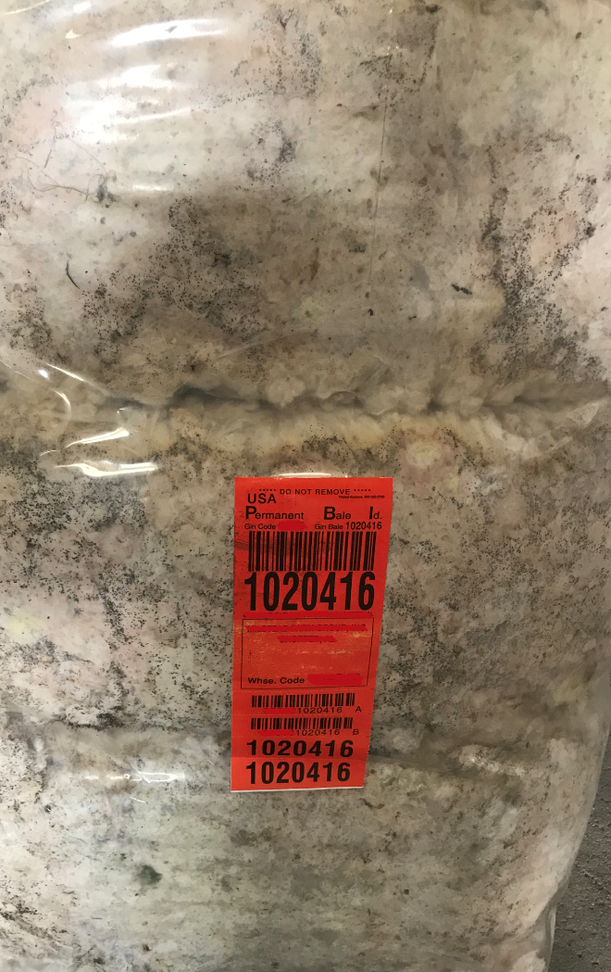
Water Damage

Slide 30
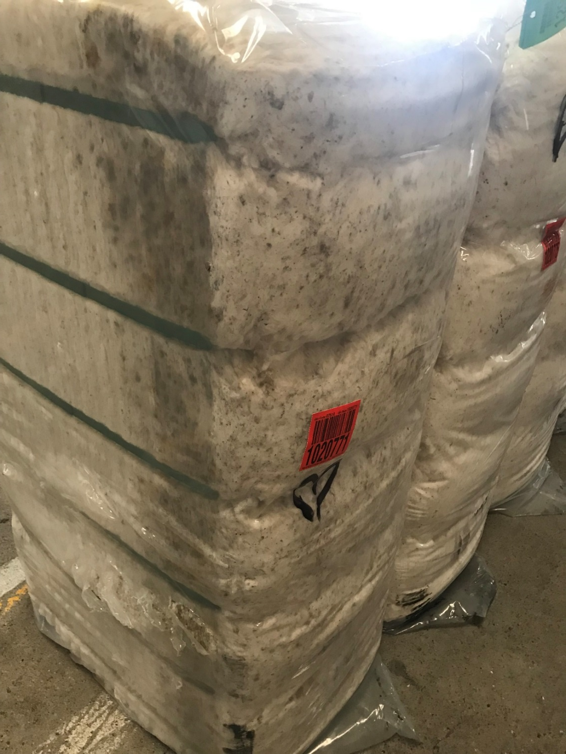
Water Damage

Slide 31
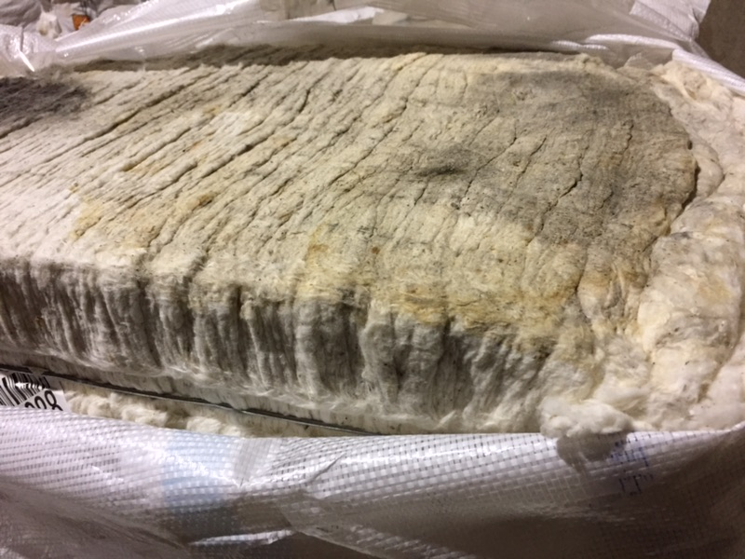
Water Damage

Slide 32
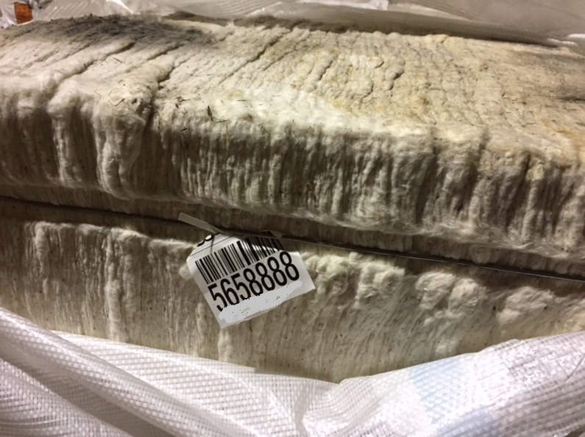
Water Damage

Slide 33
Discussion Topics
Bale Weights
Loan chart
Plastic Contamination
Moisture Damage
Metal Contamination
Fire & Insurance
Sustainability

Slide 34
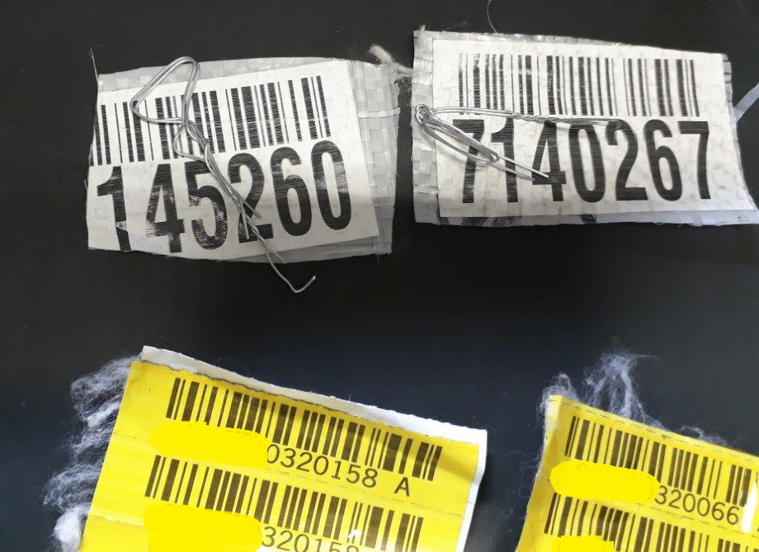
Wire in Bales

Slide 35
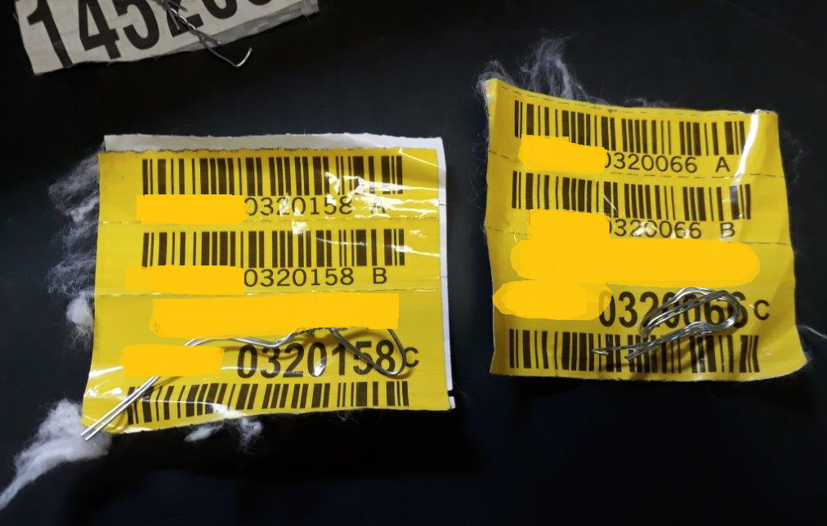
Wire in Bales

Slide 36
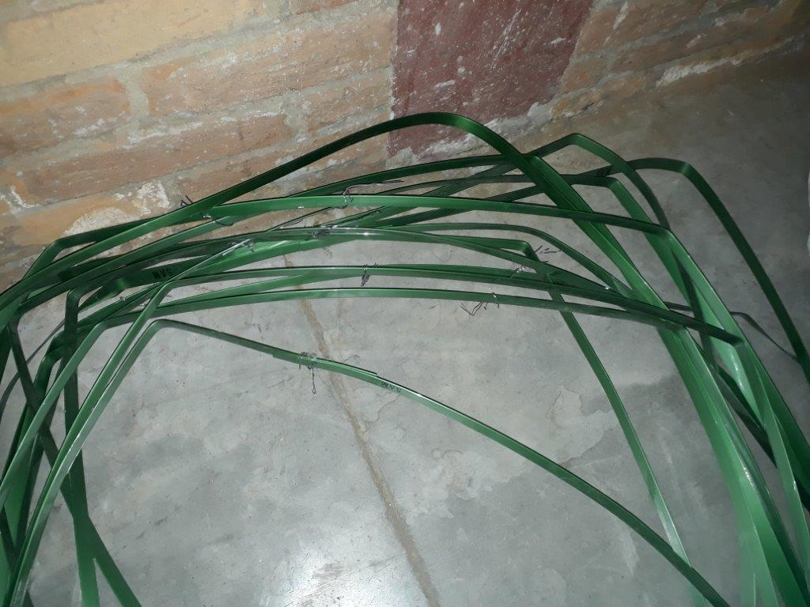
Wire in Bales

Slide 37
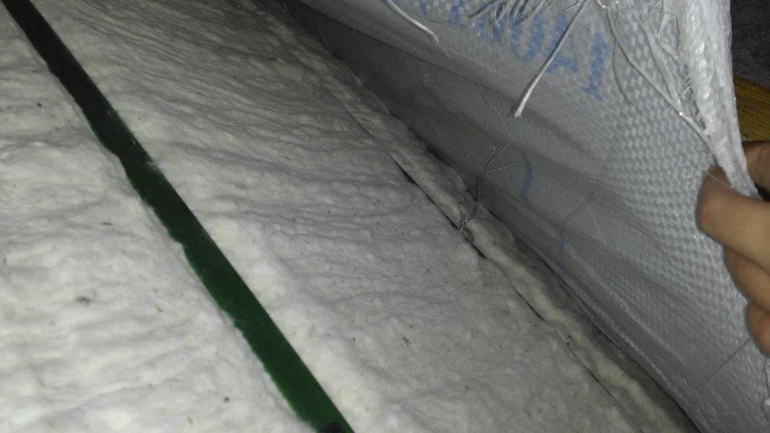
Wire in Bales

Slide 38
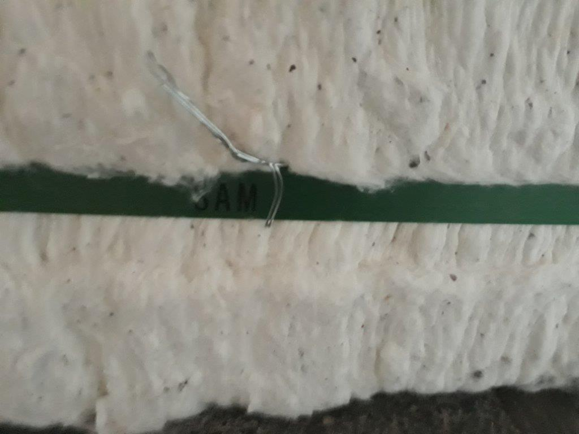
Wire in Bales

Slide 39
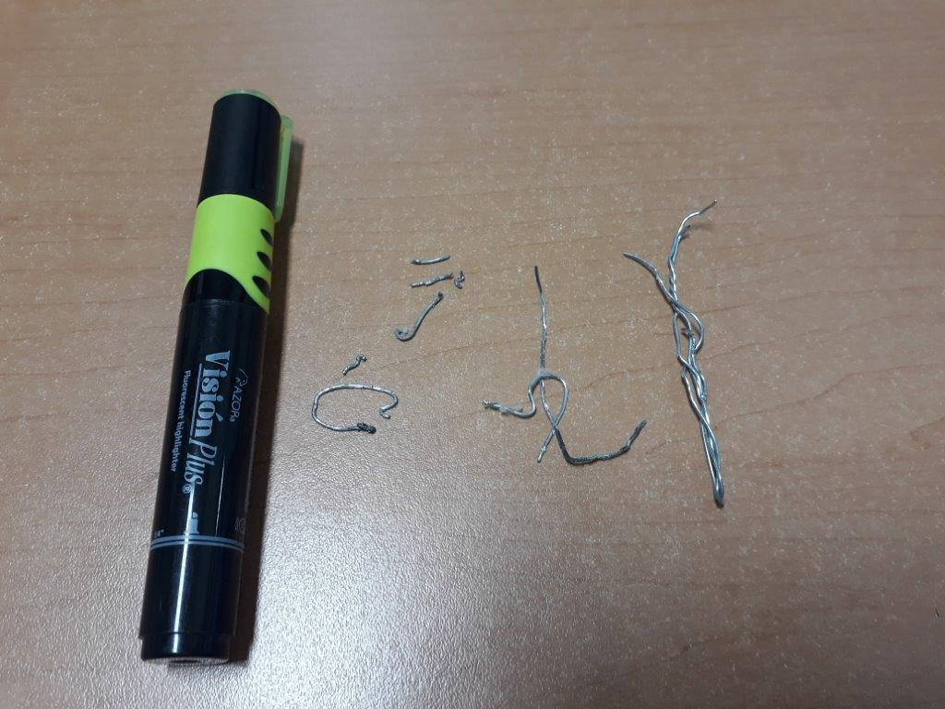
Wire in Bales

Slide 40
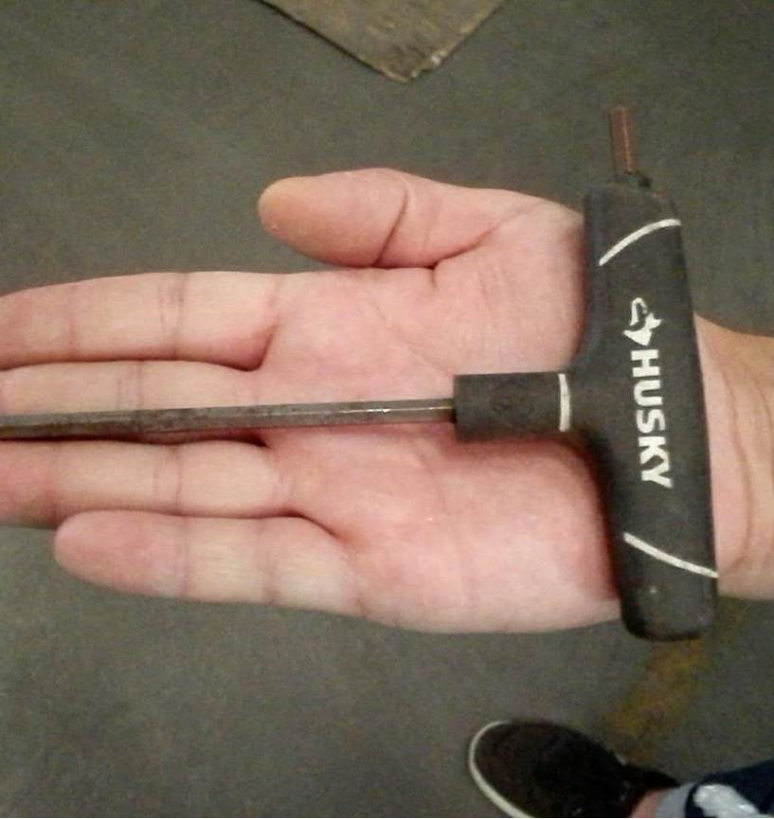
Metal Tool

Slide 41
Discussion Topics
Bale Weights
Loan chart
Plastic Contamination
Moisture Damage
Metal Contamination
Fire & Insurance
Sustainability

Slide 42
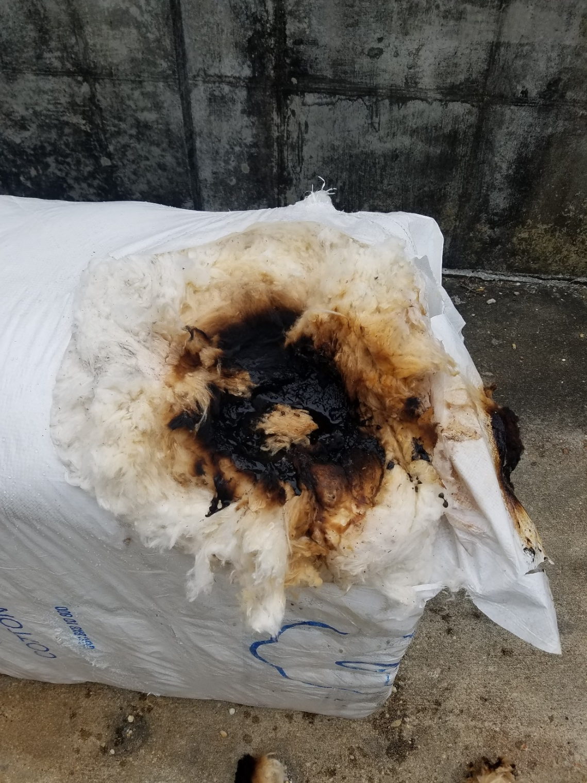
Fire Damage

Slide 43
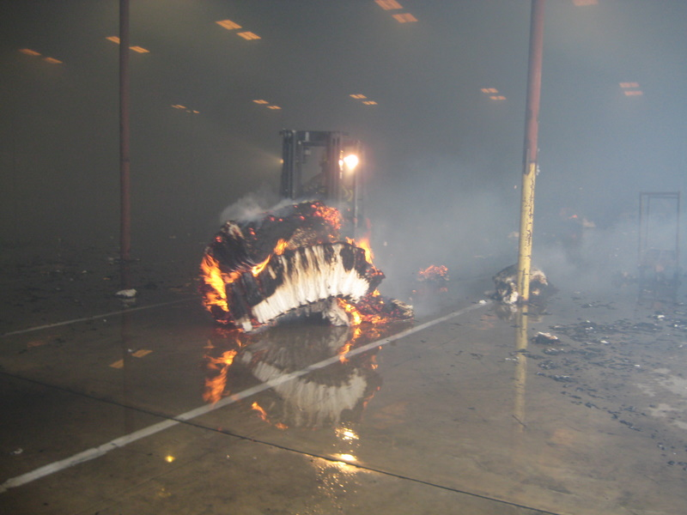

Slide 44
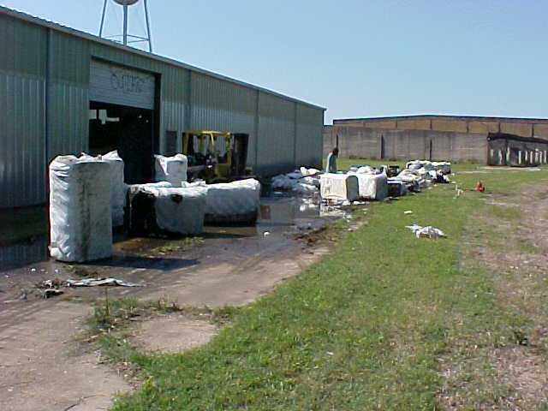

Slide 45
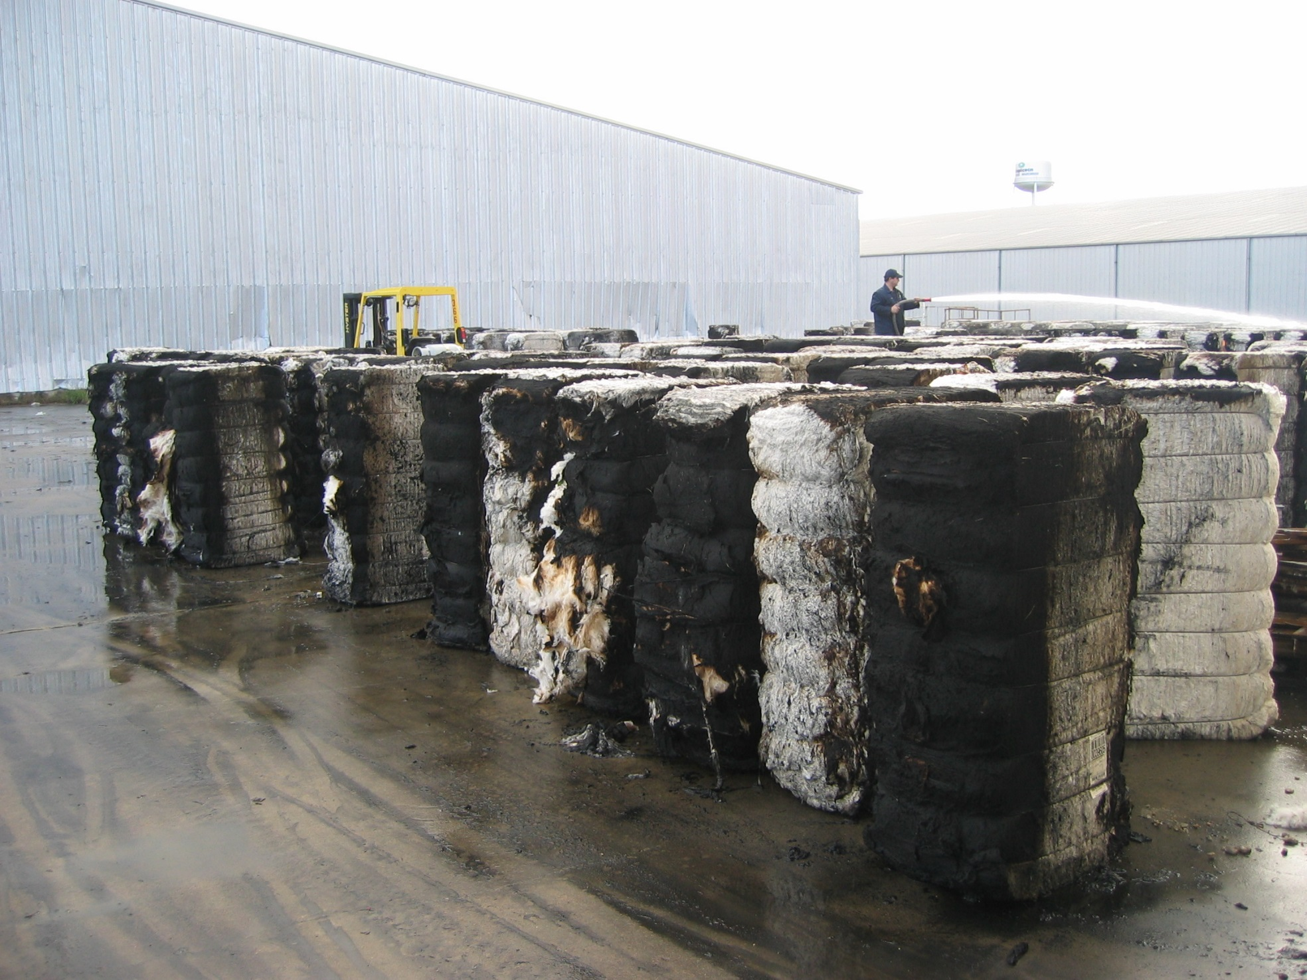

Slide 46
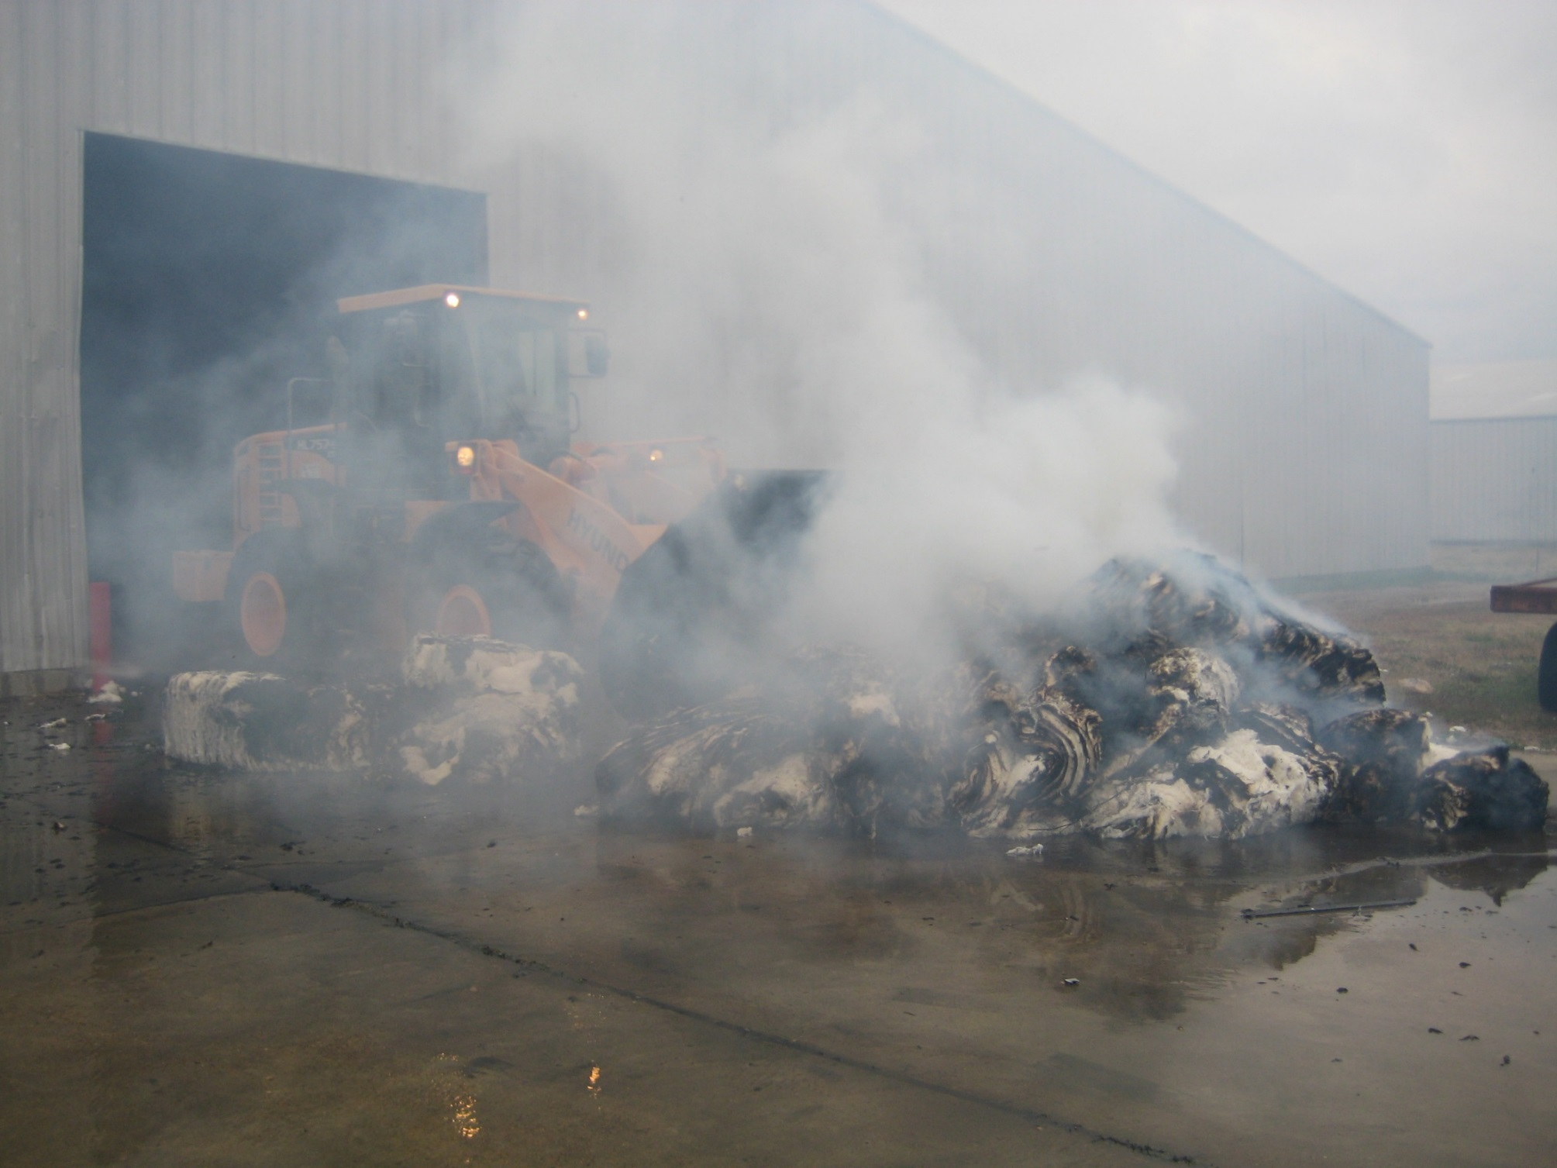

Slide 47
Discussion Topics
Bale Weights
Loan chart
Plastic Contamination
Moisture Damage
Metal Contamination
Fire & Insurance
Sustainability

Slide 48
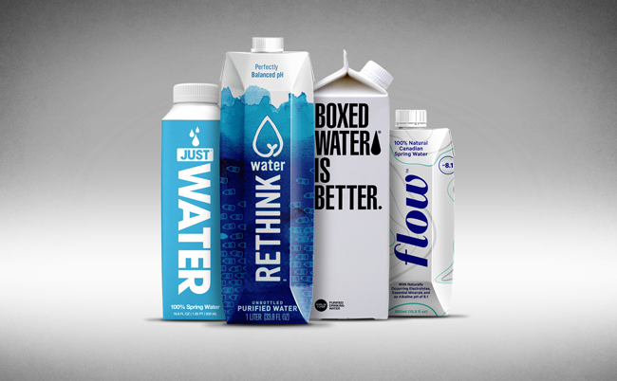
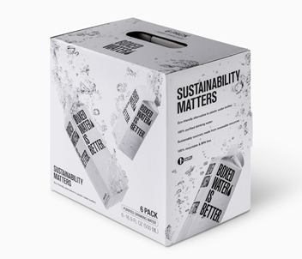
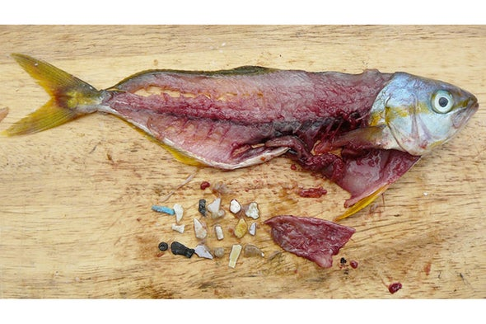
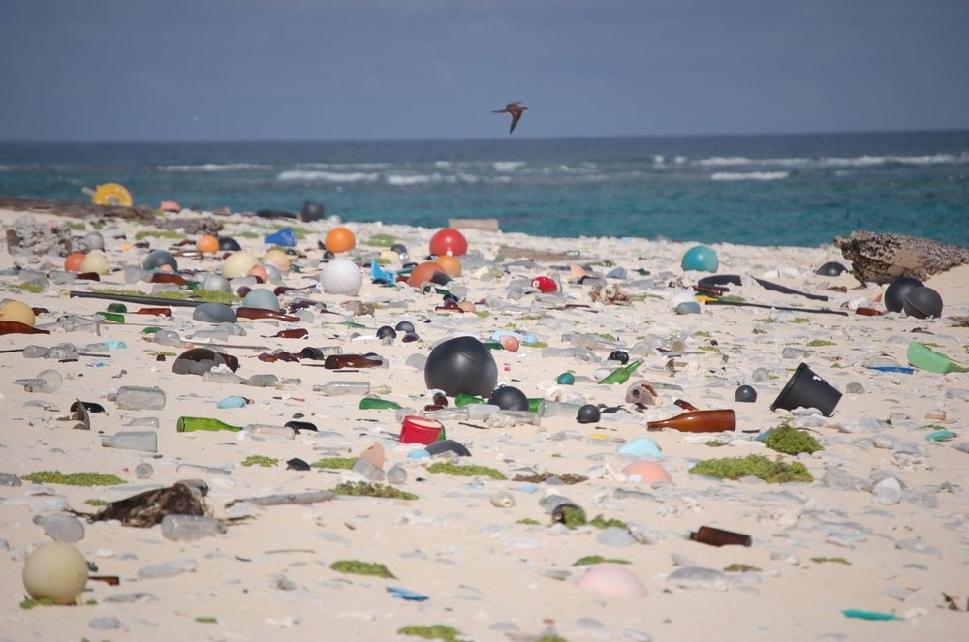

Slide 50
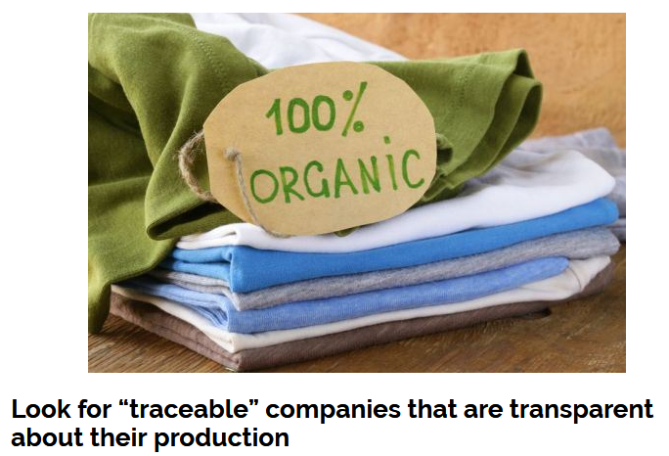
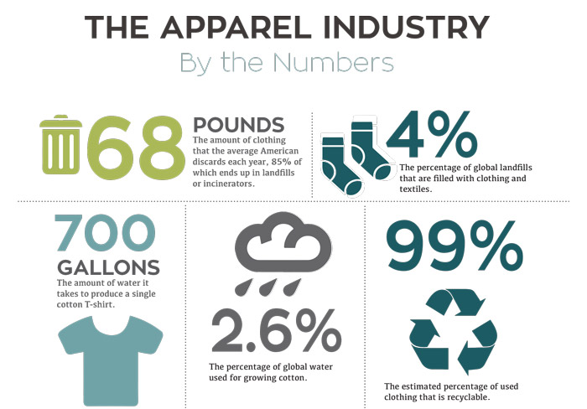

Slide 51
Thank You

